Slide 1
Troy Magennis (@t_magennis) Entangled: Solving the Hairy Problem of Team Dependencies

Slide 2
Entangled: Solving the Hairy Problem of Team Dependencies
Troy Magennis
@t_magennis
Troy.Magennis@focusedobjective.com

Slide 3
Slides, Forecasting Spreadsheets, Resources
Bit.Ly/SimResources
(case sensitive)
And live tweets direct to material here
@t_magennis

Slide 4
Take-Aways
Be aware of the impact of dependencies
A single dependency reduce order options 50%, < 1% with 4
Every dependency removed double your chance of on-time delivery
Don’t be afraid to have teams up to 15 people
if it avoids even a single dependency
Visualize your dependencies
Manage your team skill balance to avoid constraints
Get cookies aligned between teams and dependents

Slide 5

Dependency - progress of one action relies upon the timely output of a previous action, or the presence of some specific thing.
From: Strode, D.E. and Huff, S.L. A taxonomy of dependencies in agile software development. 23rd Australasian Conference on Information Systems (ACIS), (2012), 1–10.

Slide 6
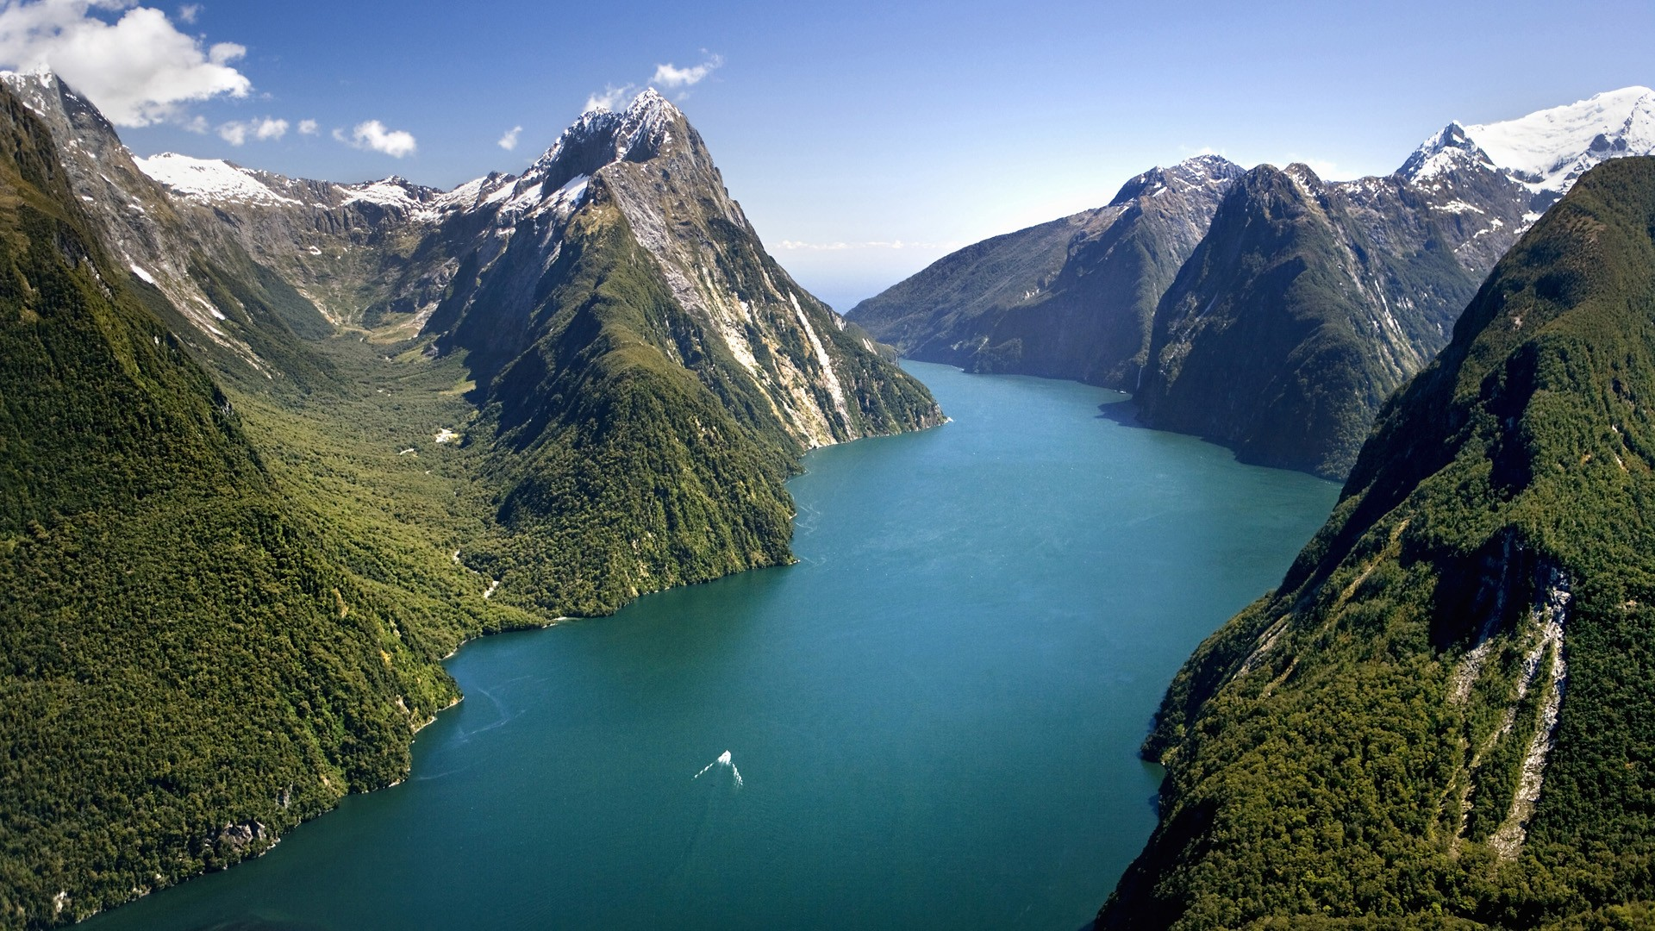
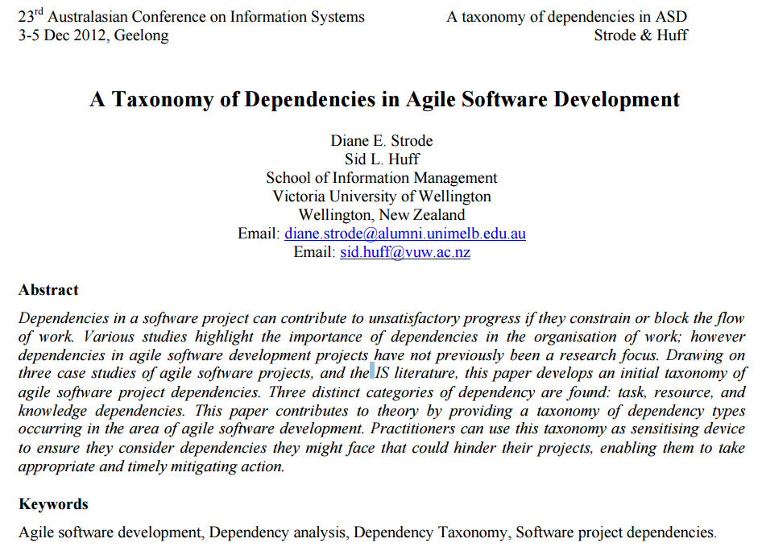
https://dro.deakin.edu.au/eserv/DU:30049080/strode-taxonomyofdependencies-2012.pdf

Slide 7
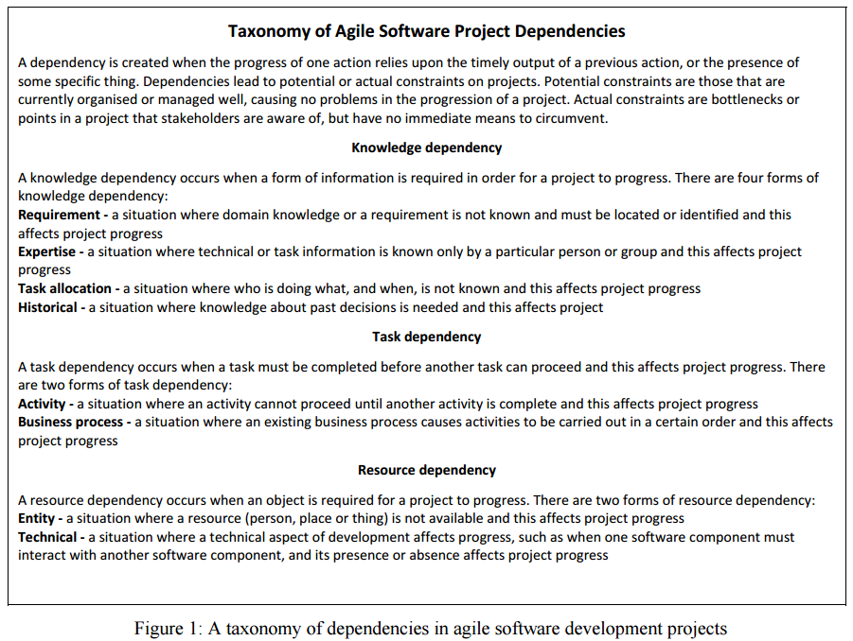
Knowledge Dependency
Requirement
Expertise
Task Allocation
Historical
Task Dependency
Activity
Business Process
Resource Dependency
Entity
Technical
https://dro.deakin.edu.au/eserv/DU:30049080/strode-taxonomyofdependencies-2012.pdf

Slide 8
Dependency - progress of one action relies upon the timely output of a previous action, or the presence of some specific thing.
From: Strode, D.E. and Huff, S.L. A taxonomy of dependencies in agile software development. 23rd Australasian Conference on Information Systems (ACIS), (2012), 1–10.

Slide 9
A situation wherein an activity cannot proceed until another activity is complete.
Dependencies lead to potential or actual constraints on projects. Potential constraints are those that are currently organised or managed well, causing no problems in the progression of a project. Actual constraints are bottlenecks or points in a project that stakeholders are aware of, but have no immediate means to circumvent.
https://dro.deakin.edu.au/eserv/DU:30049080/strode-taxonomyofdependencies-2012.pdf

Slide 10

Reduced freedom in ordering work items
Increased lead-time of work items
Causes friction between teams who have different priorities and rewards

Slide 11

Reduced freedom in ordering work items

Slide 12


http://conferences.computer.org/hicss/2015/papers/7367f124.pdf

Slide 13
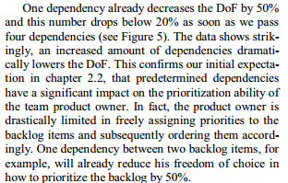
http://conferences.computer.org/hicss/2015/papers/7367f124.pdf

Slide 14

Feature A | Feature B | A before B
1 | 2 | Yes
2 | 1 | No
One dependency cuts allowed options in half
Feature start order
Feature A | Feature B | Feature C | A < B | A < B, B < C
1 | 2 | 3 | Yes | Yes
1 | 3 | 2 | Yes | No
2 | 1 | 3 | No | No
2 | 3 | 1 | No | No
3 | 1 | 2 | Yes | No
3 | 2 | 1 | No | No
Two dependencies cuts allowed options to 1/6th

Slide 15
Number of Dependencies | Valid Ordering Options
0 | 100%
1 | 50%
2 | 16.667%
3 | 4.167%
4 | 0.833%
5 | 0.278%
# valid options for 4 features | # valid options for 5 features | # valid options for 6 features
24 | 120 | 720
12 | 60 | 360
4 | 20 | 120
1 | 5 | 30
- | 1 | 6
- | - | 1

Slide 16
0
5 Features. No Dependencies. 120 unique ordering options.

Slide 17
1
5 Features. 1 Dependency. 60 unique ordering options.

Slide 18
2
5 Features. 2 Dependencies. 20 unique ordering options.

Slide 19
3
5 Features. 3 Dependencies. 5 unique ordering options.

Slide 20
4
5 Features. 4 Dependencies. 1 unique ordering options.

Slide 21

Increased lead time of work items

Slide 22

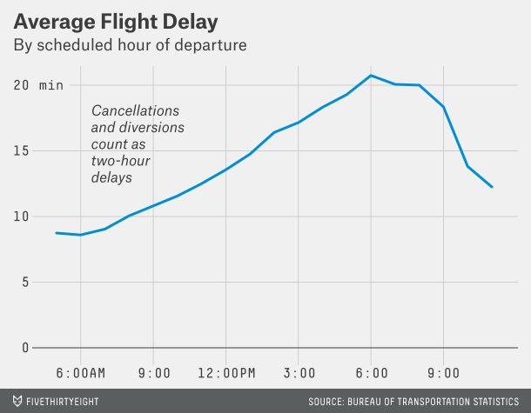

Slide 23
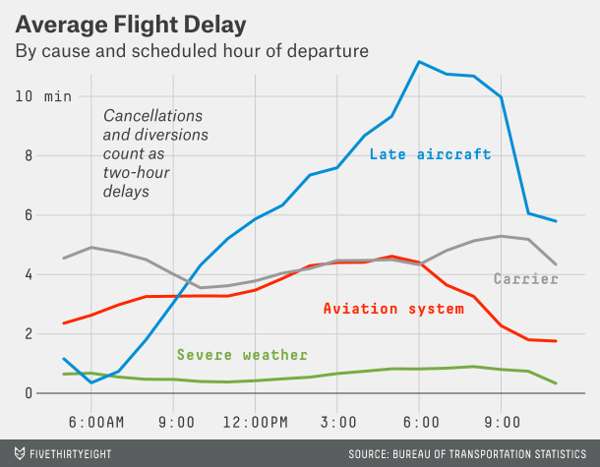

Slide 24

SEA to SFO (2 hours)
2 hours
SFO to JFK (6 hours)
1 hour un-board/board
6 hours
JFK to SFO (6 hours)
1 hour un-board/board
SFO to SEA (2 hours)
6 hours
1 hour un-board/board
2 hours

Slide 25
Four people arrange a restaurant booking after work Q. What is the chance they arrive on-time to be seated?

Slide 26
Person 1 | Person 2 | Person 3 | Person 4
1 in 16 EVERYONE is ON-TIME
15 TIMES more likely at least on person is late

Slide 27
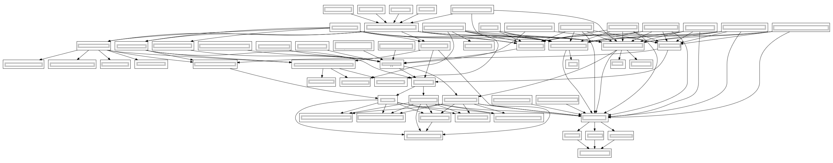
1
2
3
4
5
6
7
Team Dependency Diagram
Diagram thanks to Dan Greening (@greening) of SenexRex.

Slide 28
1 in 2^{n} ^{or}
1 in 2⁷
^{or}
1 in 128

Slide 29
7 dependencies
1 chance in 128

Slide 30
6 dependencies
1 chance in 64

Slide 31
5 dependencies
1 chance in 32

Slide 32

Time = (Optimistic + 4 x Most likely + Pessimistic) / 6
Notes:
Not trying to cause a fight, but its NOT 4 times more likely that the most likely will occur. The delays have no correlation to the items itself.

Slide 33
Delays are NOT CAUSED by the item being delayed, its caused by other factors that are unknowable (and unquantifiable) in advance.
It’s the start time we struggle to compute, PERT worries about the completion time.

Slide 34
Estimate = Sum Sprints x 1.5
If all work 1 sprint:
7 x 2 x 1.5 = 21 weeks
50% teams will miss the expected time.
1
2
3
4
5
6
7
Team Dependency Diagram
Diagram thanks to Dan Greening @greening) of SenexRex.

Slide 35
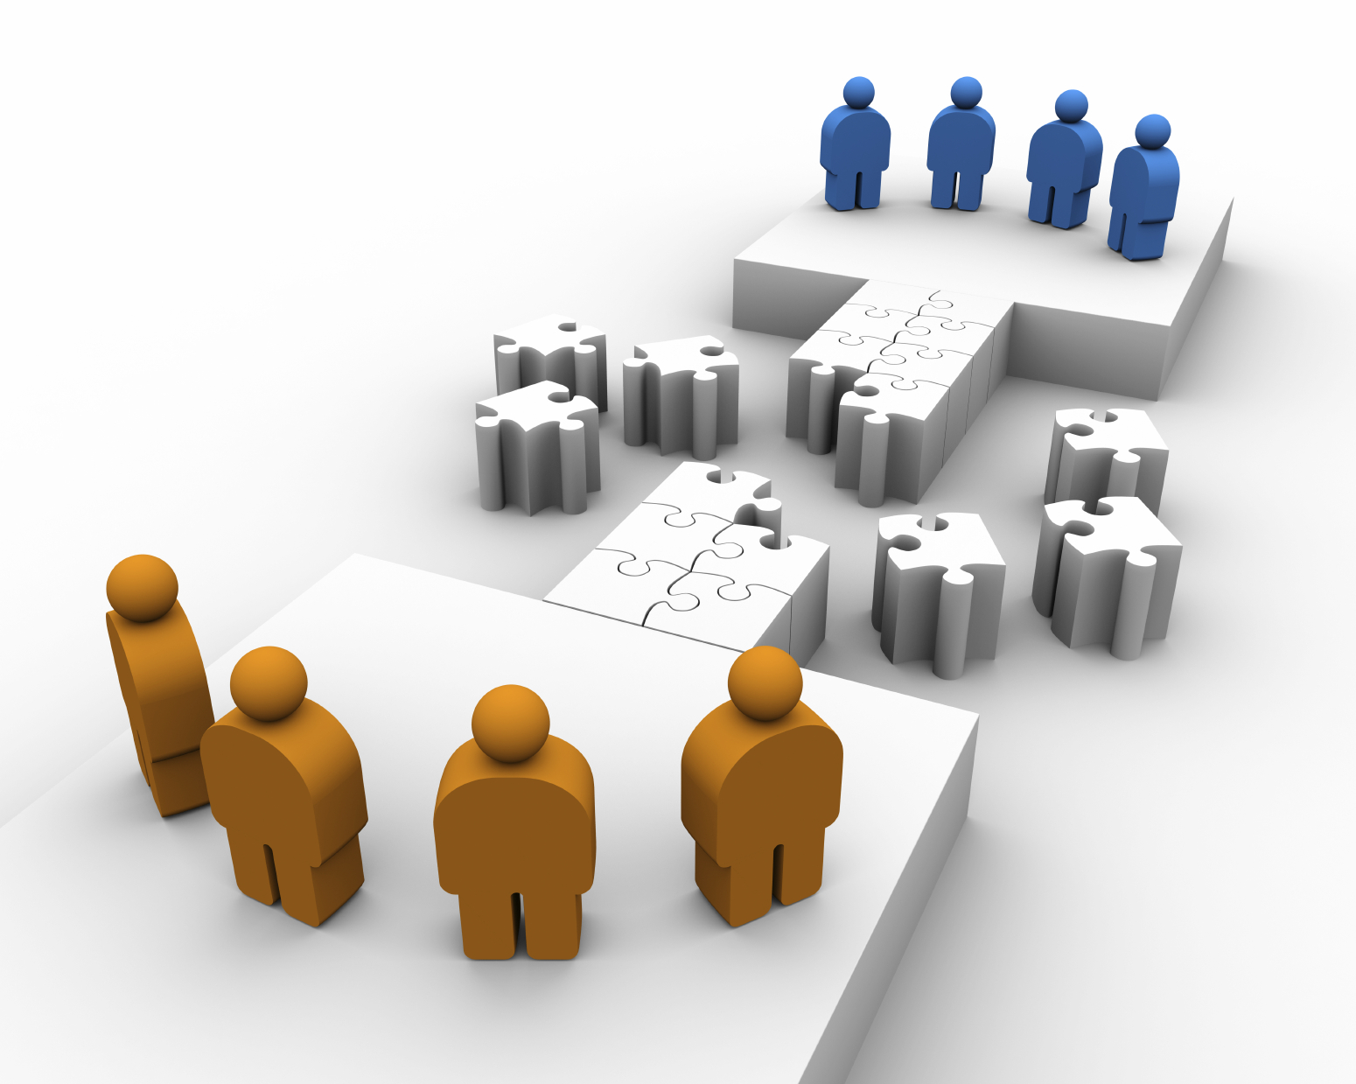

Slide 36


Slide 37
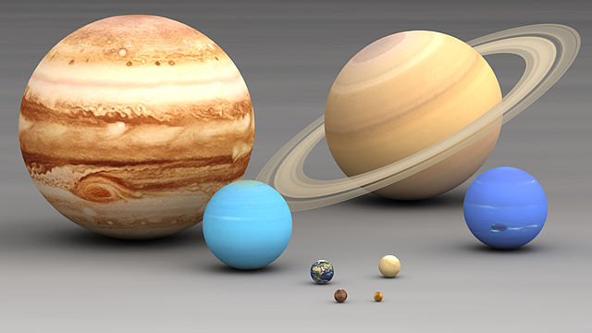
Team size impact
What causes so many small teams?

Slide 38

"The Magical Number Seven, Plus or Minus Two: Some Limits on Our Capacity for Processing Information"
George A Miller – Miller’s Law

Slide 39
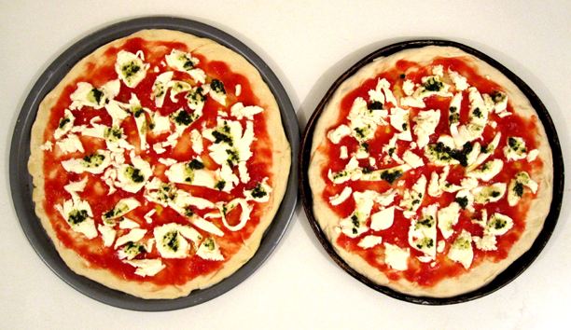

Slide 40
Number of links between people = n x (n-1) / 2

Slide 41
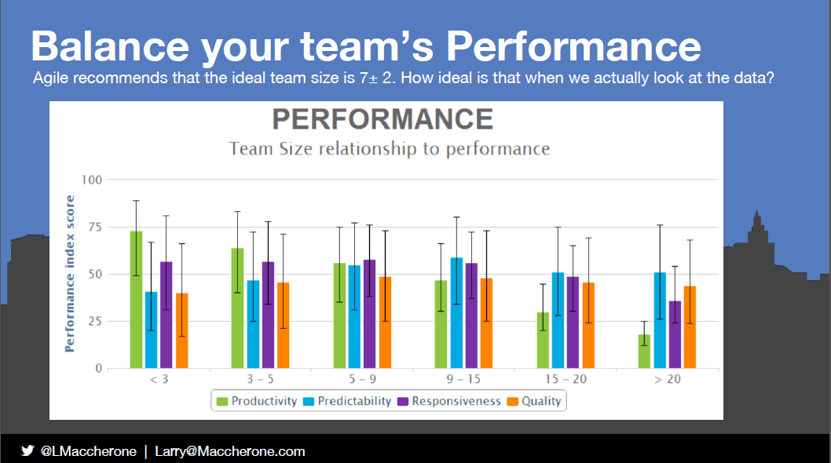
http://schd.ws/hosted_files/lkuk14/a9/Larry%20Maccherone%20-%20Impact%20of%20Agile%20Quantified%20LKUK%202014.pptx

Slide 42
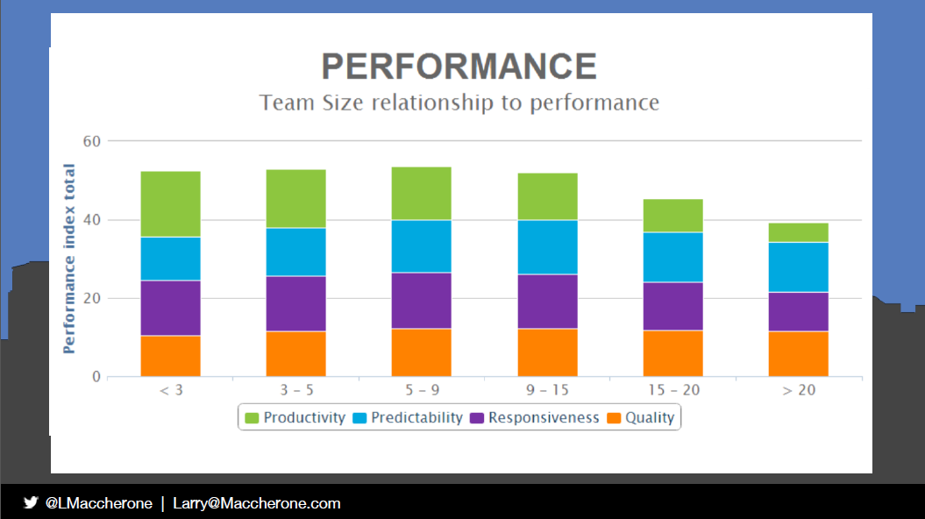

Slide 43
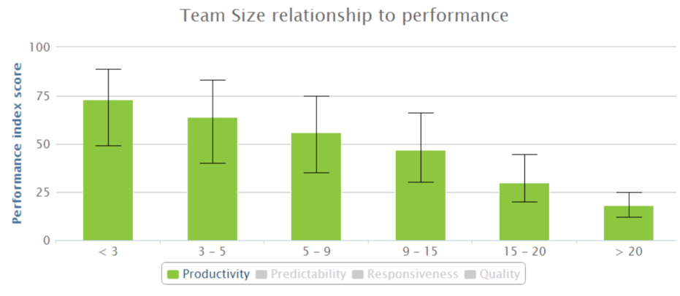
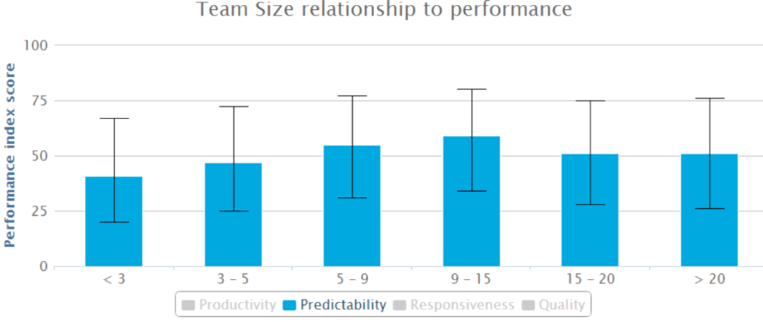
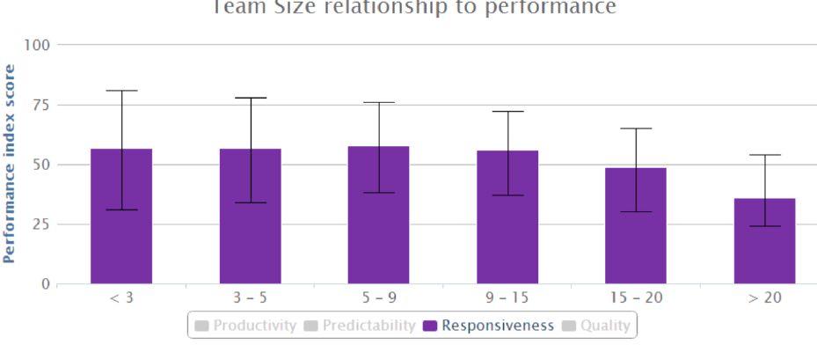
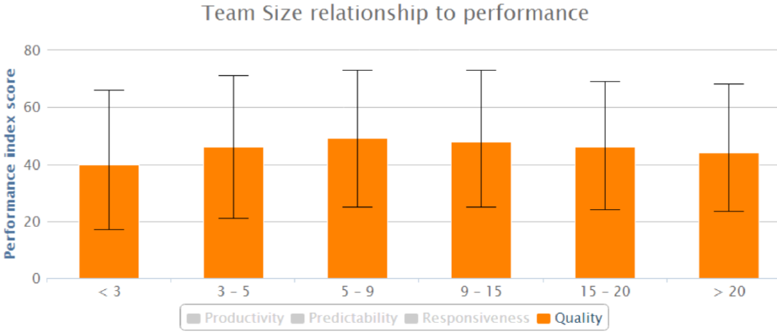
Better
Worse
~ Equal
~ Equal

Slide 44

Team Performance > System Perf.
Performance > Predictability
Team co-ordination cost is low
Keep team size smaller if…
Consider up to 15 ppl if it decreases a dependency

Slide 45

Team organization design options

Slide 46




Reducing Dependencies: Team Structure Options
Create multi-disciplined feature teams
Merge teams
Co-locate teams who depend on each other
versus

Slide 47
1. Merge
2. Co-Locate
Team Dependency Diagram
Diagram thanks to Dan Greening (@greening) of SenexRex.

Slide 48
Matrix – Component vs Feature
Component Team
Feature Team
Skill 1
Skill 2
Skill 3
Legend

Slide 49
By Skillset, Discipline or Component Area
Team 1
Team 2
Team 3
Skill 1
Skill 2
Skill 3
Skill 4
Legend

Slide 50
Component or Skillset Area Teams
Team 1
Team 2
Team 3
Pros
Consistent practices
Predictable in isolation
Complete area knowledge
Fast ramp-up of new members
Cons
Many dependencies
Low predictability as a system
No system understanding

Slide 51
By Feature
Team 1
Team 2
Team 3
Skill 1
Skill 2
Skill 3
Skill 4
Legend

Slide 52
Feature Teams
Team 1
Team 2
Team 3
Pros
Few/Any Dependencies
Predictable feature delivery
Complete feature knowledge
Cons
Divergent practices
Code / build Integration harder
Beware of single “expert”

Slide 53
Planning and Growing Teams
Skill falls into levels
Can teach others
Can do
Have the desire
No idea, and never will!
Continuous Cycle
Role of managers
Capability
Risk Exposure
Plan Skills
Assess Current
Ask Team
Train or Hire

Slide 54
Growing Teams – Skills != People
Mid State
(before split)
End State (after split)
4 ppl | Skill 1 | Skill 2 | Skill 3
Teacher | 1 | 0 | 0
Do-er | 0 | 1 | 1
Learner | 0 | 0 | 1
Start
T
T
Team 1
Team 2
graduate
T
D
Train in Triangle
D
D
T
4 ppl | Skill 1 | Skill 2 | Skill 3
Teacher | 1 | 1 | 0
Do-er | 1 | 0 | 2
Learner | 1 | 0 | 0
T
TBH
Train in
Triangle
D
TBH
D
L
D
6 ppl | Skill 1 | Skill 2 | Skill 3
Teacher | 1 | 1 | 0
Do-er | 1 | 1 | 2
Learner | 1 | 1 | 0
Train to Do-er
L
L
D
D
Notes:
At the start, team is unstable. Single point of failure Triangle and Sun. Need to resolve this urgently
Once no single point of skill constraint, grow Teachers and Doers. Look for Learners
Split and hire if necessary. Put new hires on the teams with the Teachers. Time for Doers to Graduate!!!

Slide 55
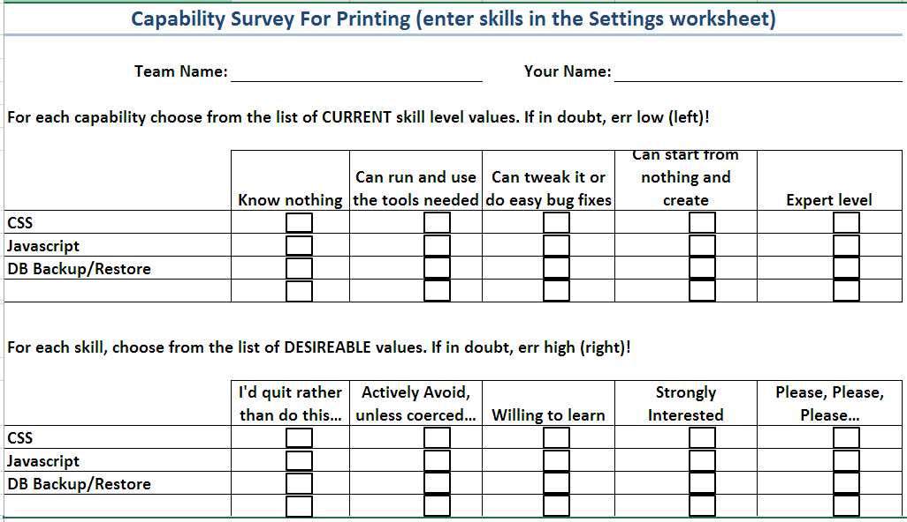
Skill Assessment – Knowing and Growing
Download from: Bit.ly/SimResources (Spreadsheets, Capability Matrix.xlsx)

Slide 56
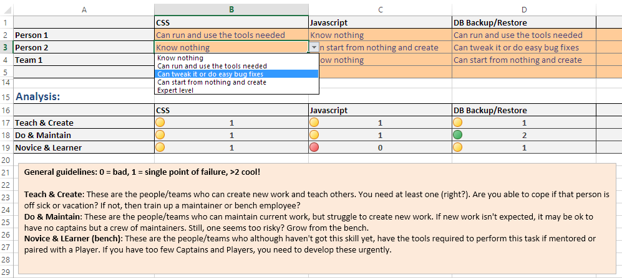
Download from: Bit.ly/SimResources (Spreadsheets, Capability Matrix.xlsx)

Slide 57

Clear and Aligned priorities

Slide 58

Incentives

Slide 59

Thanks to Lisa Long and Chris Matts for the cookie analogy.

Slide 60

Different players have different rewards.
“Do a feature, get a cookie” ~ Lisa Long

Slide 61


If rewards aren’t aligned, different ordering decisions are made

Slide 62
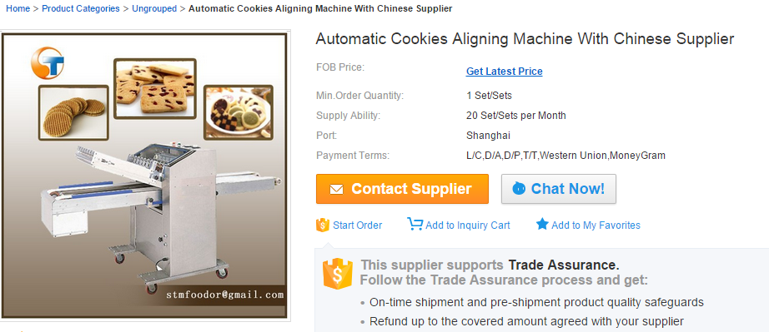

Slide 63
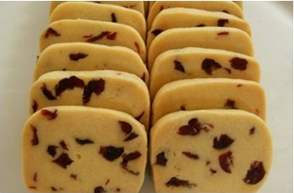

Slide 64

Friendly Competition
aligned with
Desired Outcomes
Incentives, even if light handed play a big role

Slide 65
Wrong order list
Feature 1 & 5 are prioritized
Work released to prod
Feature 1
Production Defect
Feature 2
Feature 3
Feature 4
Feature 6
Work released to prod
Feature 1
Feature 5
Production Defect
Feature 2
Feature 3
Feature 4
Feature 6
Thanks to Chris Matts, Lisa Long and John Horton for the “Wrong order’o’meter” concept.

Slide 66
Take-Aways
Be aware of the impact of dependencies
A single dependency reduce order options 50%, < 1% with 4
Every dependency removed double your chance of on-time delivery
Don’t be afraid to have teams up to 15 people
if it avoids even a single dependency
Visualize your dependencies
Manage your team skill balance to avoid constraints
Get cookies aligned between teams and dependents

Slide 67
Risk – The Final Enterprise Agile Frontier
Top 10 reasons forecasting software projects fails
Not your grandparents risk management
How and why to do agile risk management
Risk – The Final Enterprise Agile Frontier
10:45 – National Harbor 6/7

Slide 68
Thank You
Email me: troy.magennis@focusedobjective.com
Follow me: @t_magennis
Get spreadsheets and tools: http://Bit.ly/SimResources
Download the slides from program site

Slide 69
Submission Outline
When portfolio and program managers undertake quarterly (or annual) feature and portfolio planning, understanding team dependencies is made necessary to identify constraints and avoid overburdening one team. Complexity quickly grows beyond intuition after two or three team dependencies are identified, rendering current forecasting techniques unsatisfactory. This session will discuss the inadequacies of current tools and frameworks used to manage the dependency planning problem, and introduce the choices you have for reducing the complexity and new planning techniques that untangle dependencies into a doable plan.
At the end of the session, attendees will have a new understanding of the complexity team dependencies add to planning, and have a set of strategies and techniques to predictably manage products built in high team-dependency organizations. This session looks at example dependency graphs and graphical matrix techniques that are quick to build and give clear risk insight. It often shocks organizations to learn mathematically that each team dependency HALVES the chances of an on-time completion of component or delivery. With two dependencies, there is a 1 in 4 chance of no delay; with three dependencies, there is a chance of 1 in 8 delivering on-time. One large legacy application the author worked with had seven dependencies from a core library to a user interface – that is a 1 in 128 chance no team will be delayed (127 times more likely to experience one or more delays). Planning clearly needs to consider how dependencies might impact each teams ability to integrate and build.
It is not as dire as it sounds, not every team suffers the same chance of delay. We look at how to analyze historical examples of delayed work to identify types of features that will encounter dependency delays in the future. Building a map (linked graph) and matrix visualizations of team dependencies gives a basis for examining this historical likelihood of delay and planning team organization structures or staffing plans that compensate. It is possible to predictably plan in high dependency environments, its just too hard to do in ad-hoc ways. Learning Outcomes:
Understand the impact of multiple team dependencies on planning and scheduling predictability
Introduce ways to identify and visualize dependencies for planning
Understanding current strengths and weaknesses of dependency management approaches
New strategies for minimizing the impact of dependencies and planning cross team capacity

Slide 70
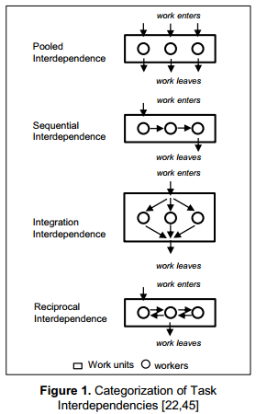
Pooled Interdependence
Specialist Teams or individuals
E.g. Supermarket checkout
E.g. ???

Slide 71
Seven +/- Two Research
https://en.wikipedia.org/wiki/The_Magical_Number_Seven,_Plus_or_Minus_Two
http://www.agiledesign.co.uk/2011/scaling-agile-teams-by-features-or-by-component
http://scalingsoftwareagilityblog.com/feature-teams-vs-component-teams-continued/
Yes, its notional and only a heuristic. But in my project base, I have seen large programs that run as much as 60-40 component/infrastructure vs features, and at least one that runs more like 80-20 feature teams/programs. Planning and execution in the latter case is just easier, for the reasons Chad and Kenny describe. One recent agile enterprise reorg was a major realignment into 12 vertical value streams, with only three horizontal/component/programs. This is intended to accelerating delivery velocity and it obviously creates a far lower number of dependent stories (less work); not to mention more facile end to end feature testing. It’s the simple physics of fewer dependencies plus increased value delivery focus that drives improved results in a feature team/program.

